Slide 1
Information Technology Institute (ITI)
Virtual Office Management Session I - OneDrive & File Management
ITI 490 Virtual Office Management - with Microsoft 365
(formerly Office 365)
Notes:
CANNOT EDIT PURPLE SHAPES OR LOGO
DIVIDER LINE IS EDITABLE
TO CHANGE IMAGE, RIGHT CLICK IMAGE, SELECT “CUT” TO REMOVE EXISTING IMAGE, AND CLICK IMAGE ICON TO INSERT NEW IMAGE
IF NO IMAGE IS IN PLACE, CLICK IMAGE ICON TO INSERT IMAGE

Slide 2
Outline
Intro to MS 365
The Cloud & File Management
One Drive
File Management

Slide 3
Microsoft 365 – Administration vs Usage
Administration
End Users
Not covered in this course
Allows you to setup which applications your ORGANIZATION can access
Covered
We are end-users in the Montgomery College Organization
Access apps via browser or via desktop applications when applicable
Notes:
Mention that these apps UPDATE frequently → you always have to monitor for updates
You consolidate files by saving them in one account (MC Credentials).

Slide 4
What is Microsoft 365?
Subscription based service (monthly fees)
Suite of apps available in the CLOUD
Apps may or may not be installed
Features vary depending on the version!

Slide 5
Microsoft 365
Formerly Office 365
Microsoft 365 is designed to help you achieve more with innovative apps, intelligent cloud services, and world-class security
It is a productivity suite in the cloud (for work and life); SaaS (Software as a Service)

Slide 6
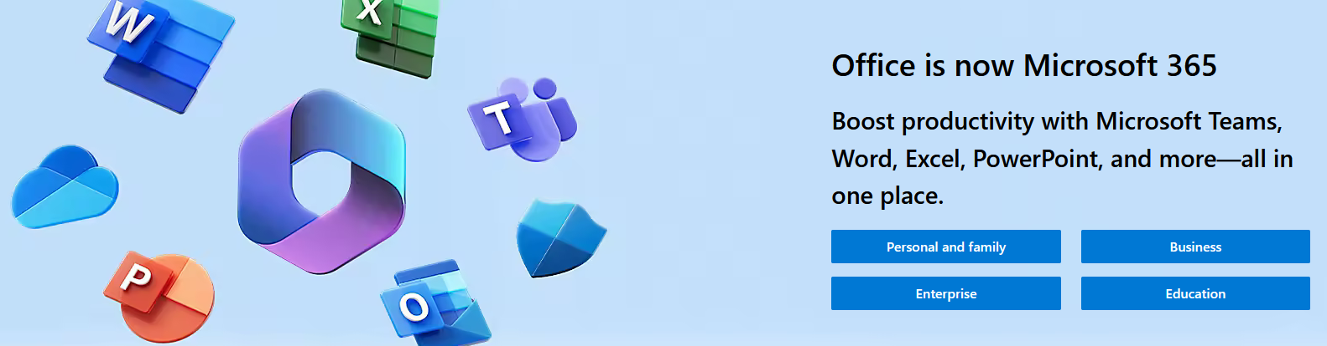
Microsoft 365

Slide 7
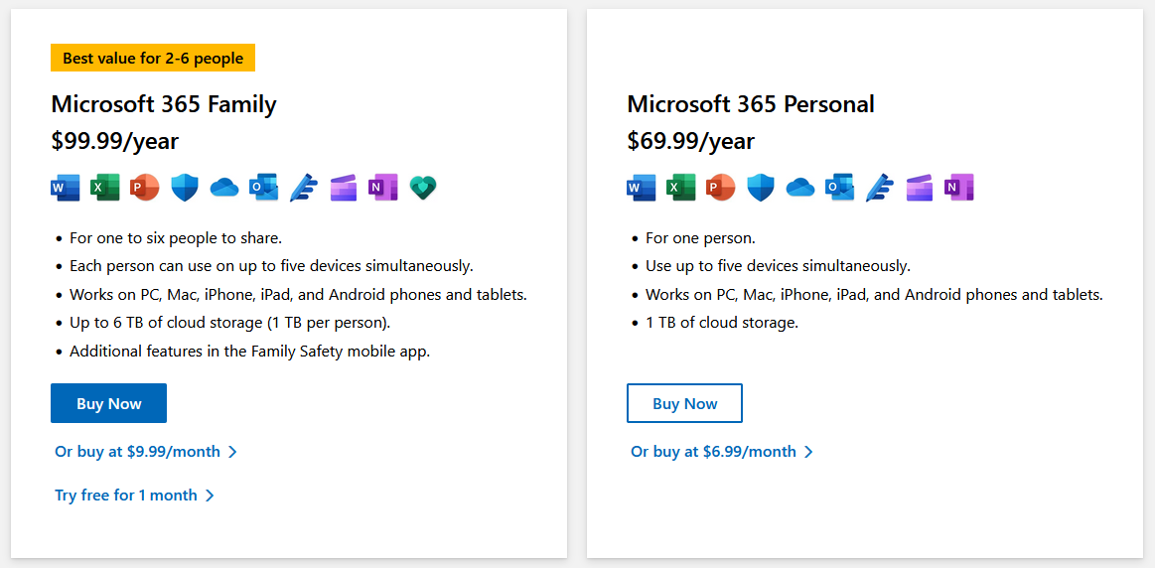
Exploring the different subscription plans
https://www.microsoft.com/en-us/microsoft-365/products-apps-services
Notes:
Go over plans
1 tb is 85,899,345 pages of word docs
Office FOR HOME: Family vs Personal
Mention the Mobile apps
Remind them you can have more than one account logged in
Remind MC account is a managed account --> some restricted apps
Warn about one-time purchase
Personal account unique features --> Personal Vault --> Remind them of the likelihood of them managing two accounts at the same time.

Slide 8
Benefits of Microsoft 365
https://www.microsoft.com/en-us/microsoft-365/products-apps-services
Notes:
Go over plans
1 tb is 85,899,345 pages of word docs
Office FOR HOME: Family vs Personal
Mention the Mobile apps
Remind them you can have more than one account logged in
Remind MC account is a managed account --> some restricted apps
Warn about one-time purchase
Personal account unique features --> Personal Vault --> Remind them of the likelihood of them managing two accounts at the same time.

Slide 9
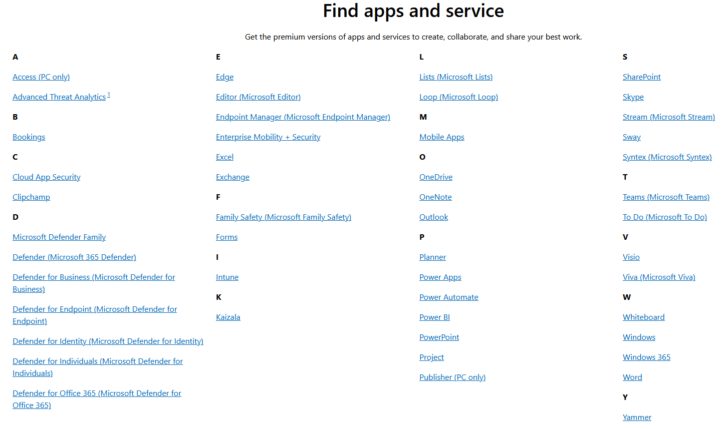
Apps and Services in Microsoft 365
Notes:
Show which we have access to
Some are not there because they are included as part of another service (Calendar is considered part of Outlook)

Slide 10
Web Version / App Version
Office 2016, 2019, & 2021 are sold as a one-time purchase.
Microsoft 365 is a subscription that includes:
Up-to-date features
Integrated experience
Robust Office desktop apps
latest features, fixes, and security updates
ongoing tech support at no extra cost.
Subscription are:
Monthly
Yearly
Microsoft 365 Family plan - up to 6 people, and use your apps on multiple PCs, Macs, tablets, and phones.

Slide 11
WE have access to Microsoft 365 for free
With our Montgomery College accounts

Slide 12
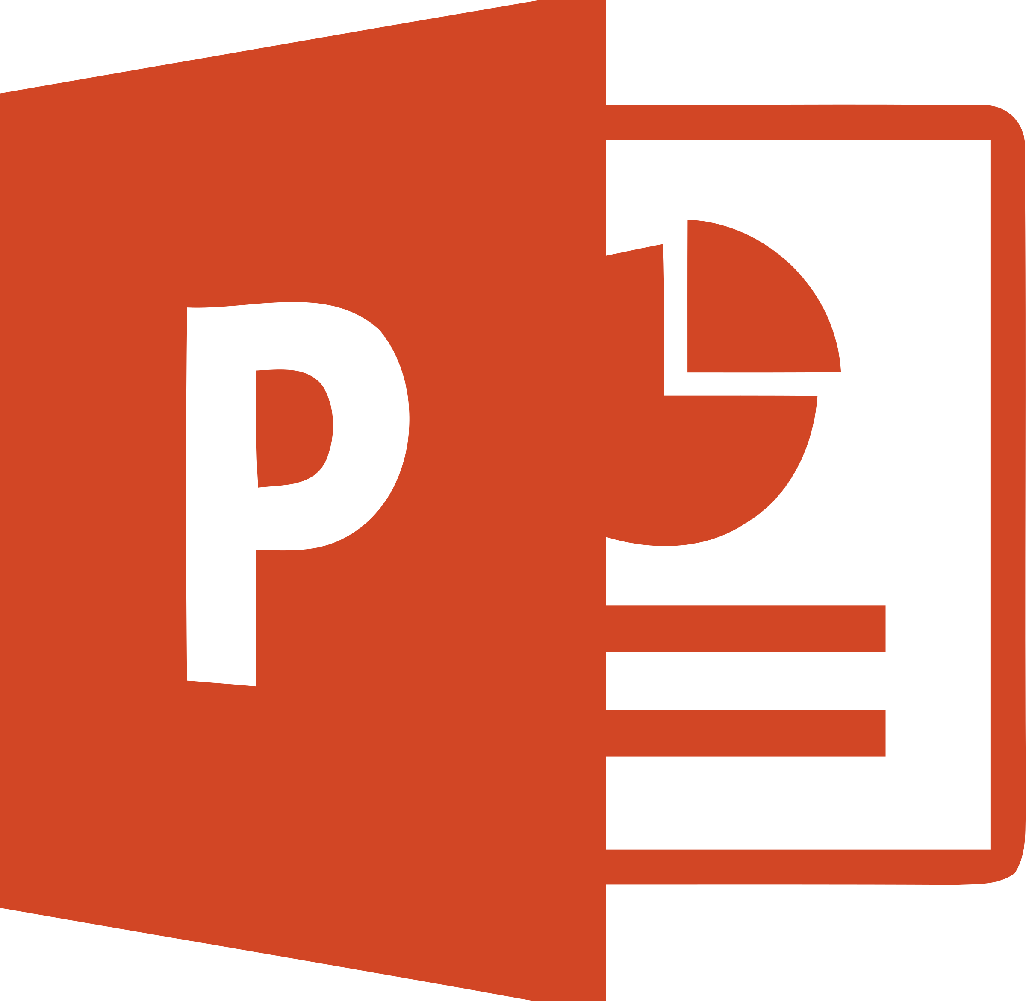
Apps we will use and focus on
MS 365 Apps
Notes:
OneDrive– store access and share your files in one place
Word – Bring out your best writing create virtual documents suited for resumes business letters faxes planning etc
Check for Sharepoint and Power Access later on
Log into via MyMC, then show them how to log via Office Webpage

Slide 13
What is the Cloud?
Simply put, the cloud is the World Wide Web (WWW) and the use of the Internet to deliver content – more specifically, it's all of the things you access remotely over the Internet.
When something is in the cloud, it means it's stored on Data Servers in multiple Data Centers instead of your computer's hard drive.

Slide 14
The Cloud
Server
Client (Desktop)
Client (Phone)
Client (Laptop)
Client (another laptop)

Slide 15
Storing Files
Local Storage
Virtual Storage (Cloud)
Limited to the hardware at hand
Data safety dependent on hardware security
Data access limited on hardware
Data integrity (corruption)
Physical locations
Scalable on demand
Data safety → Credentials
Access anywhere, anytime*
Auto-backup
Better data-integrity
*Servers may go down
Notes:
Show the students how to see their available memory

Slide 16
Web Version versus App Version
Web Version
App Version
allows fastest access
no need to install
open your browser and log in
limited list of features
only one version available
requires installation before usage
not all applications have a desktop version
desktop versions may vary by year version (2016 vs 2019 vs 2021)
full set of features per year version
Notes:
Go to Word Doc
Go over installation (they should practice at home). No need to worry about losing files if they change versions.
After that, go over signing in to One Drive, they will have to practice every time, etc. Then, use QS guide to cover bases + Testing OneDrive folder creation

Slide 17
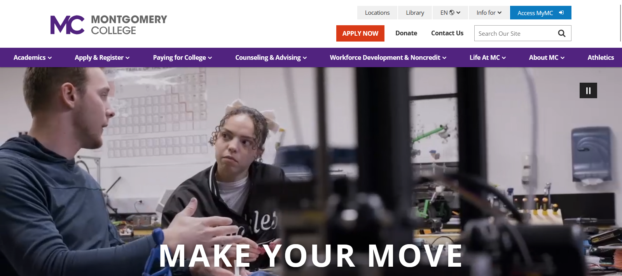
Exercise 1
In this exercise you will access your MyMC Account.
Click on the Access MyMC button on the MC Homepage.
Review MC Account & Office Setup PDF > Files > General > Account Setup

Slide 18
Exercise 1
If you have not claimed your account - do so now.
If you have claimed your
account enter your username and password.

Slide 19
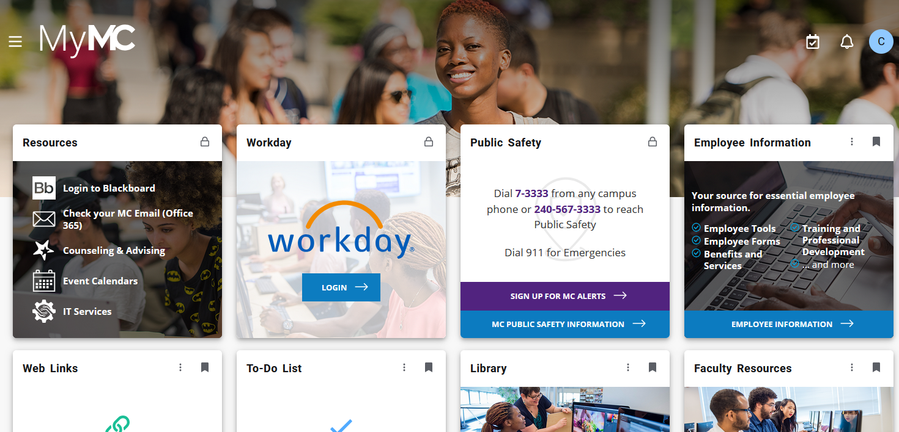
Exercise 1
Click on Check your MC Email (Office 365)

Slide 20
Exercise 1
Apps (Waffle)
Email
Calendar
People
Groups
To Do
OneDrive

Slide 21
Exercise 2 - Enroll in DUA Mobile 2FA
Download and read the PDF guide
https://montgomerycollege.login.duosecurity.com/central/

Slide 22
Exercise 3 - Sign into Canvas
Sign into Canvas - - https://canvas.instructure.com/enroll/MNB9K6
Create an account:
Join Code: MNB9K6

Slide 23
Exercise 3 - Sign into Canvas
Access the VOM Course Canvas Site
Click on Course Website

Slide 24
Microsoft OneDrive
File Management via the Cloud

Slide 25
Outline
Intro to OneDrive
Getting Started
Work with Files and Folders
Use OneDrive with MS 365
Collaborate with Others

Slide 26
What is Microsoft OneDrive?
Video Link: What is OneDrive?
Microsoft OneDrive is a cloud-based file storage application

Slide 27
What is Microsoft OneDrive?
OneDrive gives you one place to store, share, and sync your files
You can save your files in OneDrive and then work with them from almost any device
Upload files from your PC or Mac
Share files with others
Give others permission to edit files and work on them at the same time
Get to your files from anywhere, on your computer, tablet, or phone
Sync OneDrive to your PC or Mac, so you can access your files even when you're offline

Slide 28
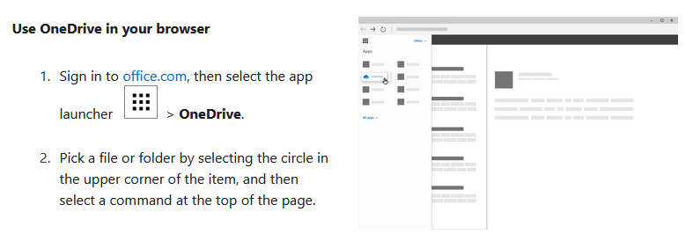
Upload and Save Files and Folders to OneDrive

Slide 29
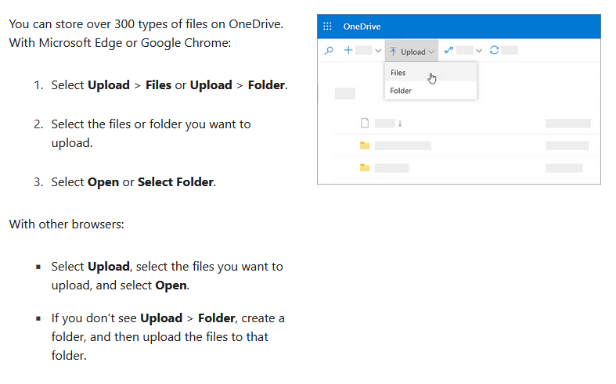
Upload and Save Files and Folders to OneDrive

Slide 30
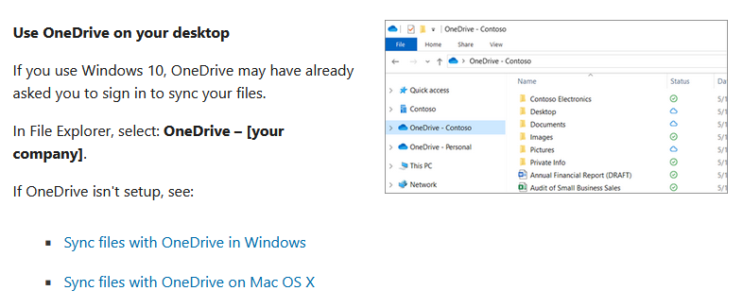
Use OneDrive on your Desktop

Slide 31
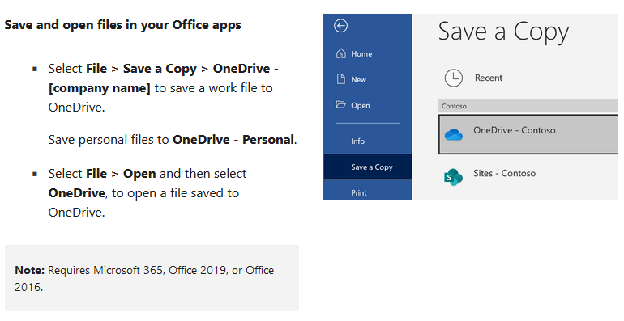
Save and open files in your locally installed Office apps

Slide 32
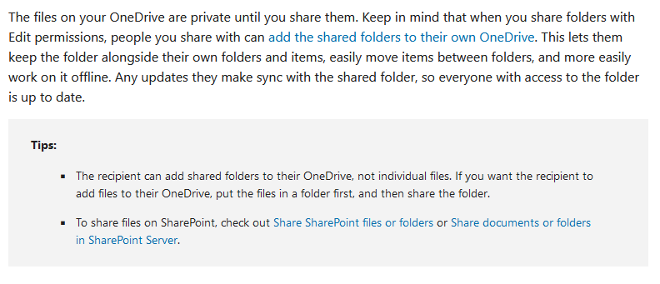
Share OneDrive Files and Folders

Slide 33
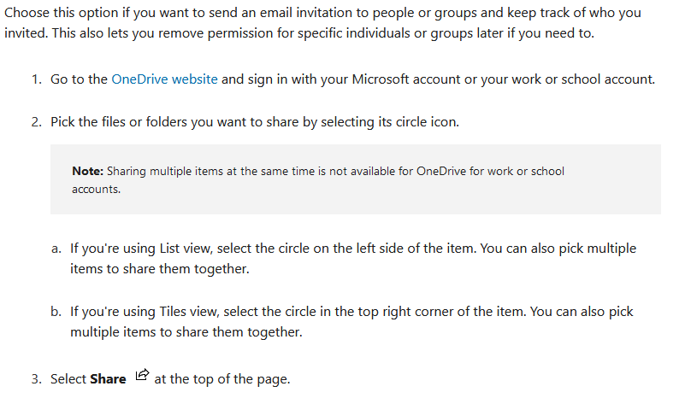
Share Files & Folders with Specific People

Slide 34
Getting Started with OneDrive

Slide 35
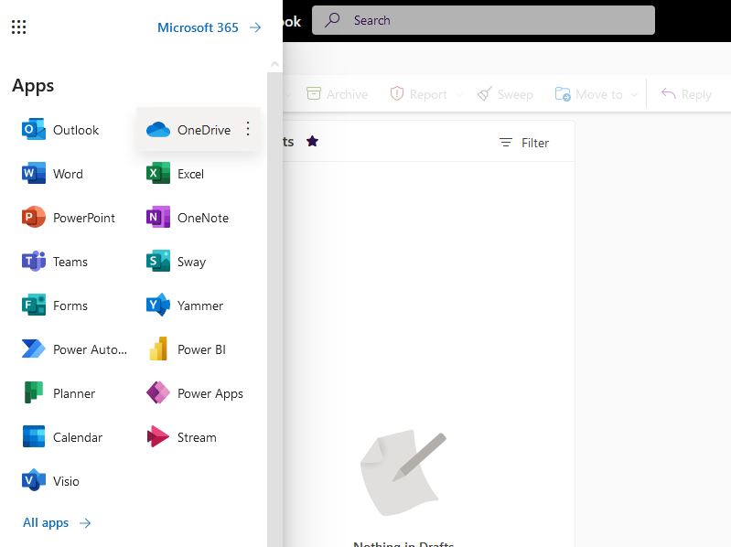
Access OneDrive in 365
Click the App Launcher
This may be referred to as the waffle
2) Click on the OneDrive app

Slide 36
File Management in OneDrive

Slide 37
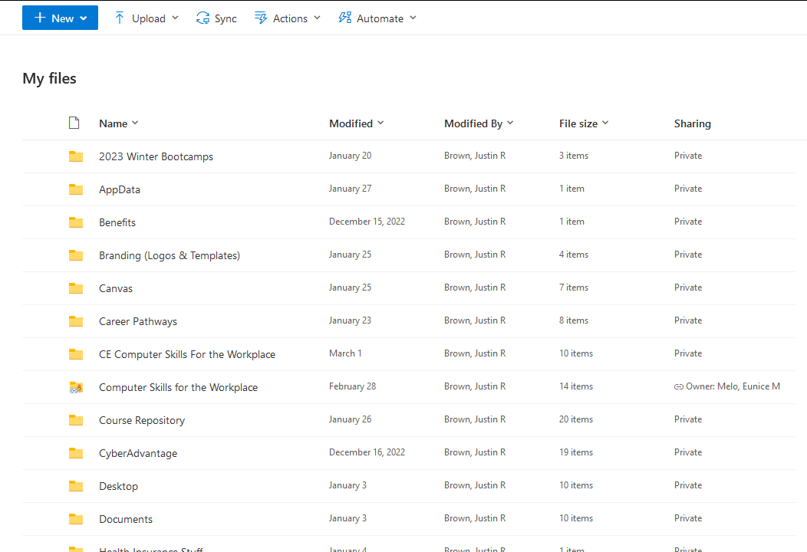
File Folders in OneDrive
Private Folders
Owner of the Shared Folder
Example of a Shared Folder

Slide 38
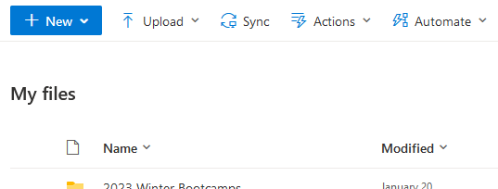
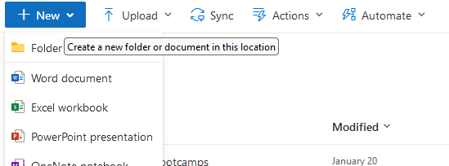
Create a new folder in OneDrive
1) Click ‘New’
2) Click ‘Folder’

Slide 39
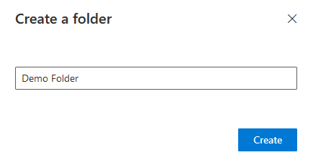
Name your Folder Ex: Demo Folder
Type the name of the folder here
Once done, click ‘Create’

Slide 40
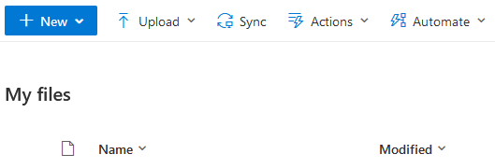
The new folder now appears in ‘My files’
Demo Folder just created
NOTE: Files & Folders will remain private unless you share them

Slide 41
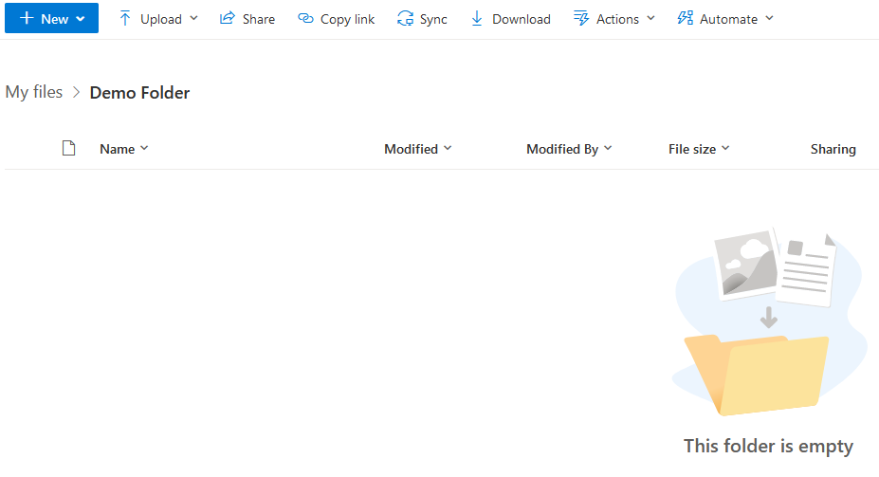
The new folder is empty until content is added

Slide 42
Work with Files and Folders
Upload from Web
Upload via OneDrive Client App
Organize Files and Folders
Rename, download and work with files
Delete and Recover Files
Search Files

Slide 43
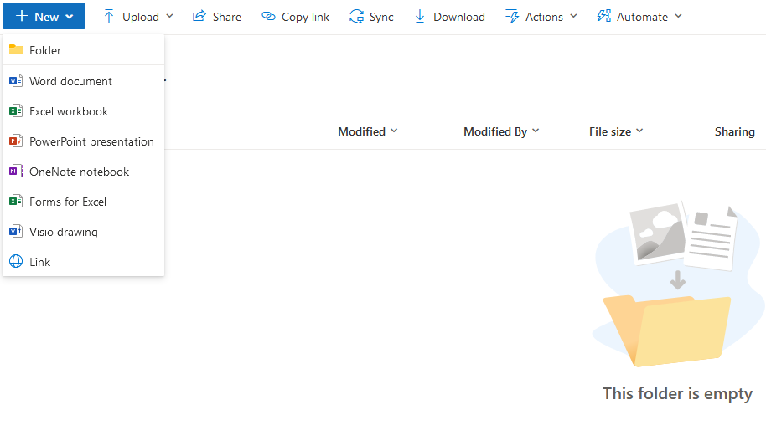
Create a new Word document in this folder
1) Click ‘New’
2) Click ‘Word document’

Slide 44
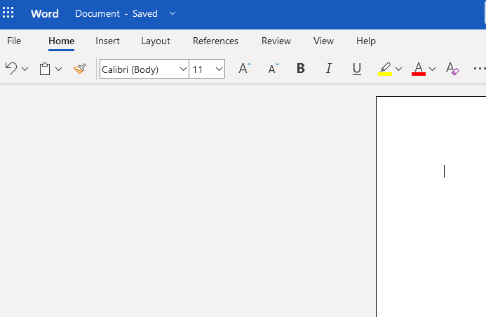
Word will open in a new tab or window

Slide 45
Save the Word document to OneDrive
Click ‘File’

Slide 46
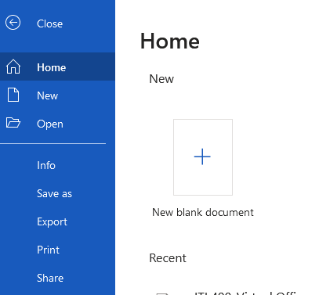
Save the Word document to OneDrive
Click ‘Save as’ to give the file a name

Slide 47
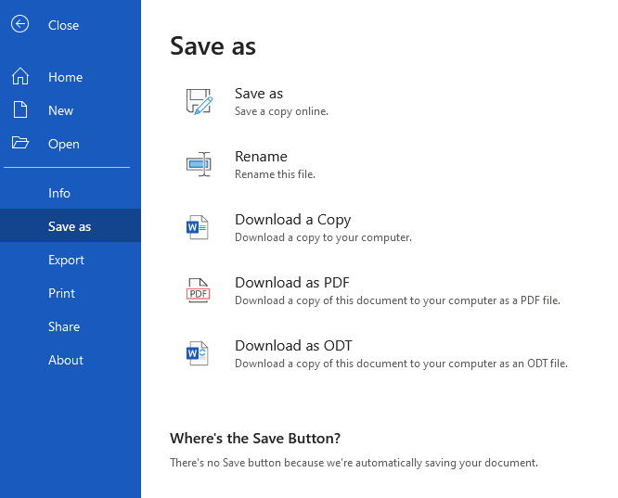
NOTE: We are working with the cloud version of Word; there is no ‘save’ button as you would see on the locally installed app
Click ‘Save as’ to give the file a name
NOTE: Because we are working with the cloud-based app, auto-save is enabled

Slide 48
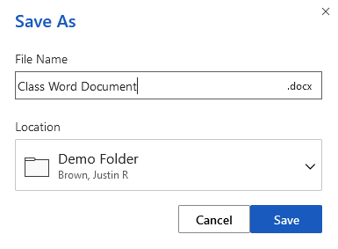
Save the Word document to OneDrive
Name the file ‘Class Word Document’

Slide 49
The Word (.docx) file now appears in ‘My files’
Our file is private by default
NOTE: Files & Folders will remain private unless you share them

Slide 50
Use OneDrive with MS 365
Save a File to OneDrive
Use OneDrive with Desktop Apps
Use OneDrive with Teams
Restore Previous Versions of Files

Slide 51
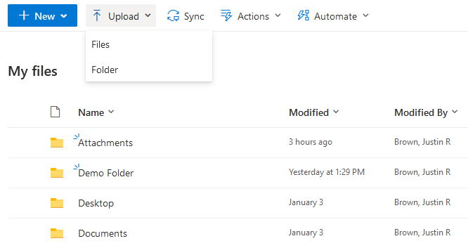
Upload a Local File or Folder
(one already on your computer)
1) Click Upload
2) Click ‘Files’ to select one or more files; Click ‘Folder’ to select a folder

Slide 52
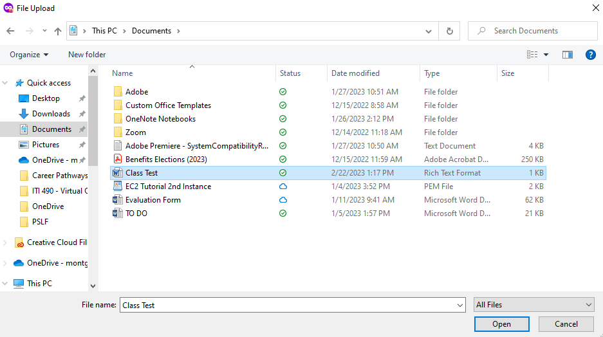
Upload a Local File or Folder
(one already on your computer)
You will navigate to the desired file or folder on your device
Select the file or folder; click ‘Open’

Slide 53
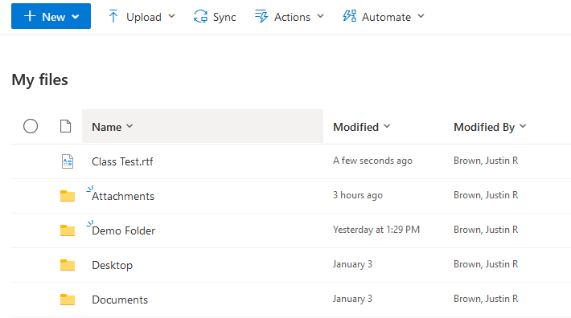
Upload a Local File or Folder
(one already on your computer)
Your file or folder will now appear in OneDrive

Slide 54
Private vs. Shared: Files & Folders
All Files & Folders will be Private when you initially create or upload them
If you share a folder with a single person, or numerous people, then ALL of those people will have access to that folder and ALL files inside the folder
If you only want to share a specific file within a folder, then select ONLY that file (do not share the folder in this case)
As the owner of the folder or file you can change access to the file at any time (the owner is the individual who initially shared the folder or file)

Slide 55
Sharing a Folder
Highlight the respective folder and click ‘Share’

Slide 56
Sharing a File
Highlight the respective file and click ‘Share’

Slide 57
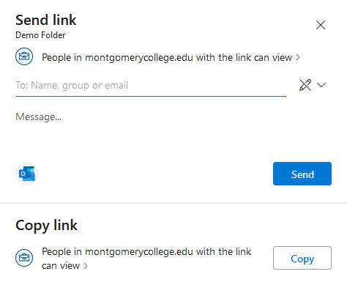
Control Permissions When Sharing a File or Folder
Click here to edit permissions for the folder or file
Type the recipient’s Email Address here
Click ‘Send’ to send the invitation to the designated recipient(s)

Slide 58
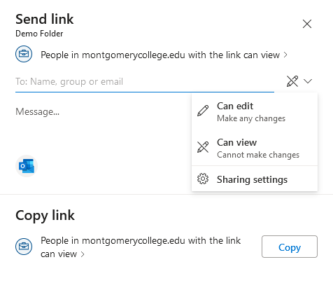
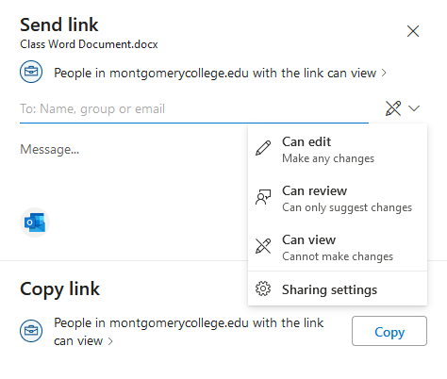
Permissions Options: Folders vs. File
FOLDER
FILE
Folder Options
File Options

Slide 59
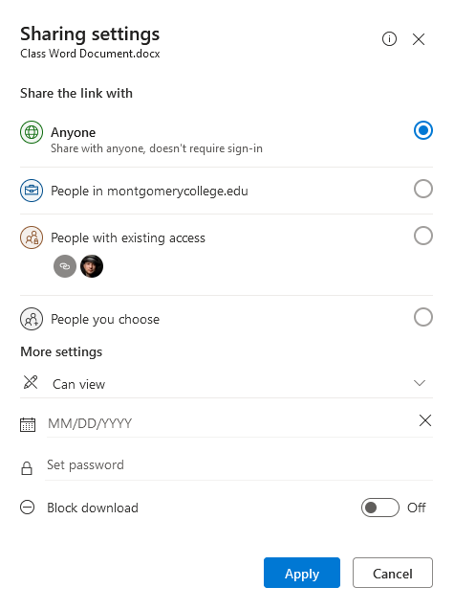
Security Features
Permissions Options: Folders vs. File
Sharing settings
Set an expiration date to limit how long a recipient(s) may access the File or Folder
_______
Password Protect the File or Folder
Control whether recipient(s) may download the file or folder

Slide 60
Permissions Options: Summary
Can edit: This allows the recipient to have complete control of the folder or file; they can edit without restrictions
Can review: This allows the recipient to simply send you suggestions for changes (they do not have the ability to change the file)
Can view: This only permits the recipient to look at the folder or file; they are not granted the ability to make changes or send suggestions for changes
Sharing settings: This option allows you to edit whether you would like to be able to share the folder or file with people OUTSIDE of your organization

Slide 61
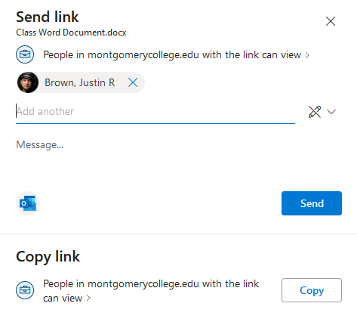
Send the Share Link to the Recipient
Add recipient(s)
Click ‘Send’ when ready

Slide 62
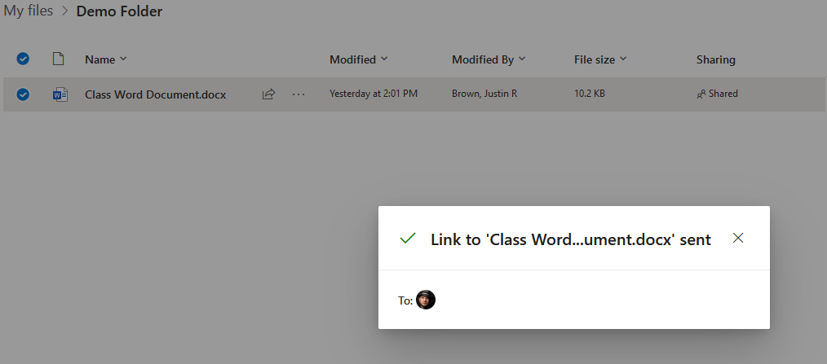
Confirmation of Link Sent

Slide 63
File or Folder status will change for Shared
Status changes from Private to Shared

Slide 64
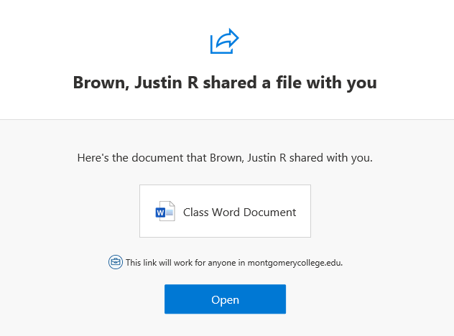
The Recipient Receives an Email to the Shared File or Folder
The recipient(s) will click ‘Open’ to be taken to the shared File or Folder

Slide 65
Sharing Files & Folders vs. Sending via Email
You can do either, but when sending files as attachments you won’t be able to collaborate on them. You are simply sending the recipient a copy of the file.
Also, if you have multiple files or want to share many at once it is easier to share a folder rather than attach many files to an email.
Another option is to compress multiple files into a folder (such as a Zip folder); this is still only useful if you don’t want to collaborate and just want to send an example of the file.

Slide 66
Collaborate with Others
Share Files and Use Links
Request File Access
Work Simultaneously With Others
Add Annotate PDFs
Use with Mobile Device

Slide 67
Collaborate on Files with Other People
Both the above Excel Spreadsheet & Word Document have been shared with a colleague named Josiah. Note that he has also modified the documents.

Slide 68
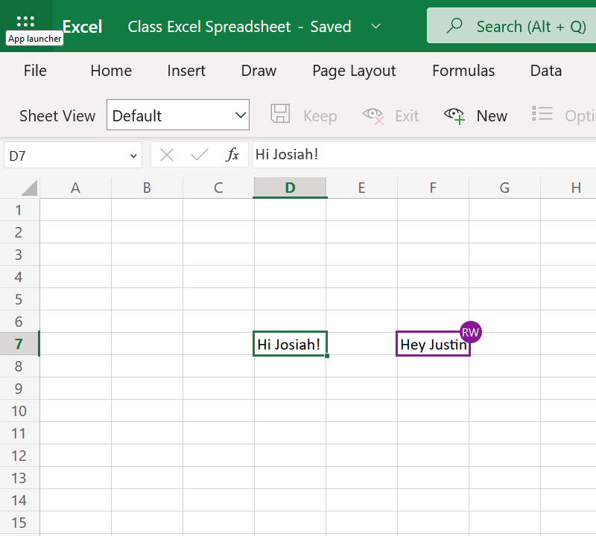
Collaborate on Files with Other People
In the example here, both Josiah and you are editing the Excel Spreadsheet at the same time
When you collaborate in real time, you’ll see your team members’ initials highlighted
That’s you
That’s your team member

Slide 69
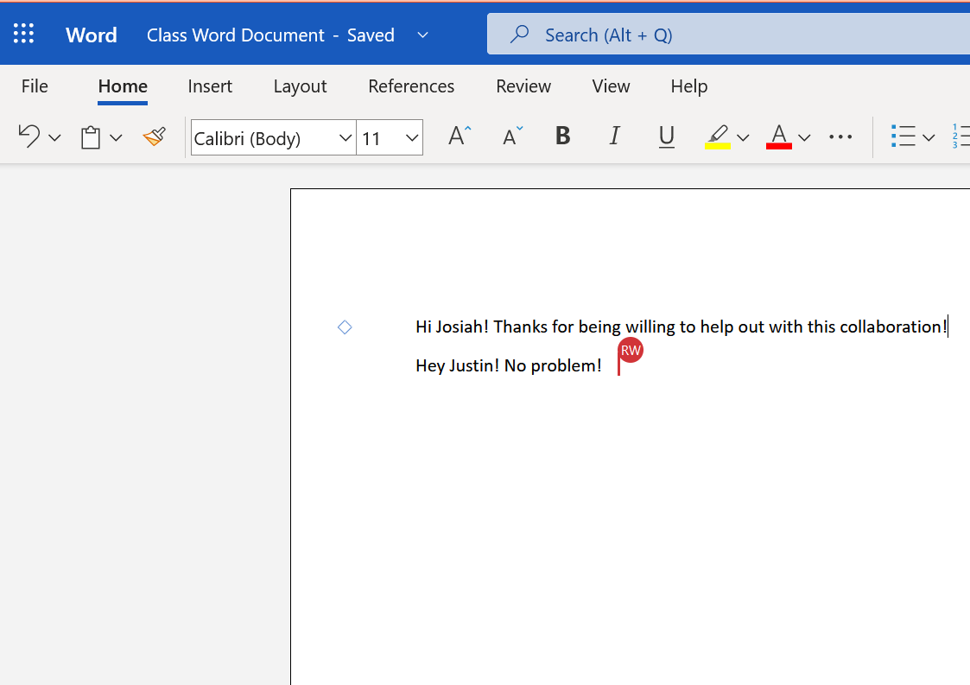
Collaborate on Files with Other People
Here both Josiah and you are again, except now you’re editing the Word Document at the same time
Once again, you’ll see Josiah’s initials highlighted in the document
That’s you
That’s your team member

Slide 70
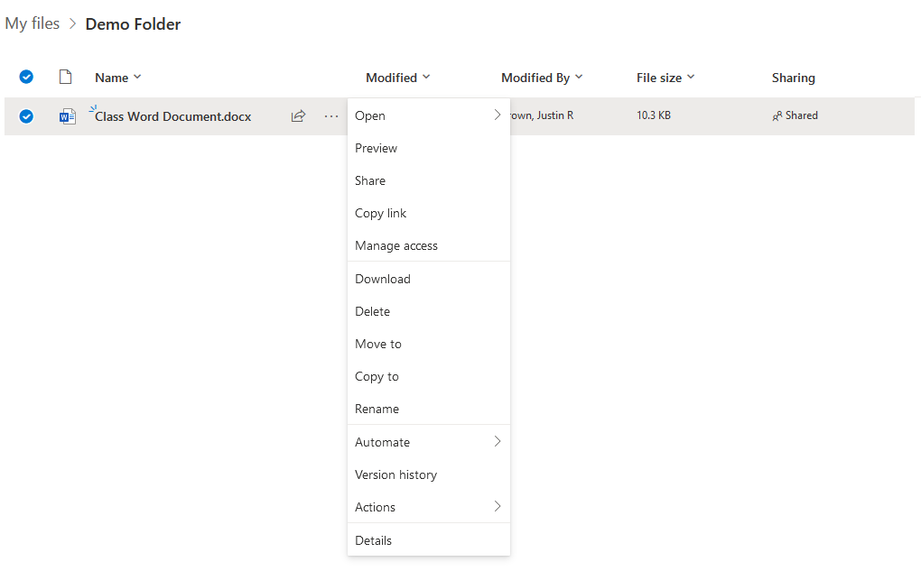
Stop Sharing a file or folder
Click the Three-Dot Menu Icon to bring up the menu of options for a file
Click ‘Manage access’ to remove shared access to a file or folder

Slide 71
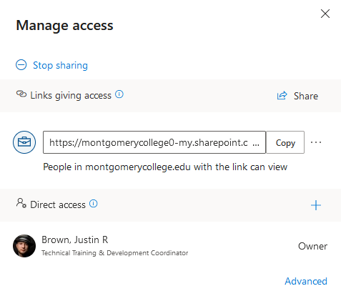
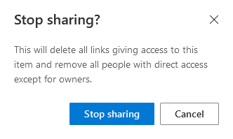
Stop Sharing a File or Folder
You’ll receive this prompt; click ‘Stop sharing’ again to remove access
Select ‘Stop sharing’ to remove access to a file or folder

Slide 72
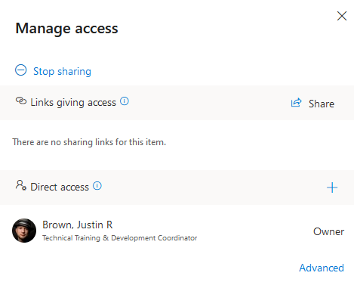
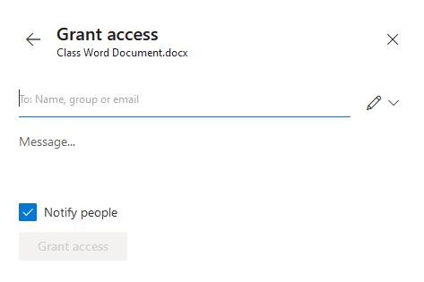
Manage Access to a File or Folder

Slide 73
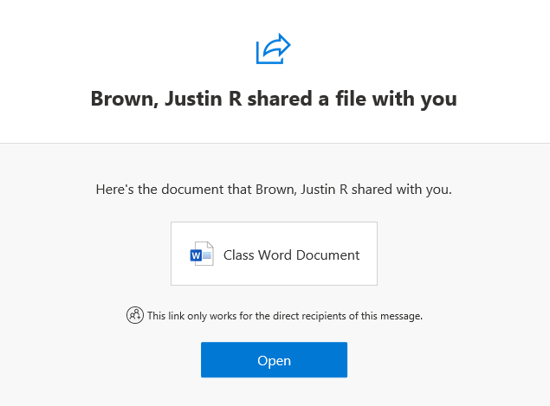
Manage Access to a File or Folder

Slide 74
Version History

Slide 75
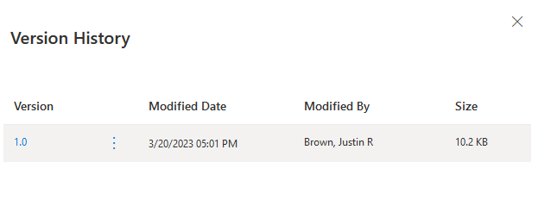
Restore a File to a Previous Version if Undesired Changes Were Made
Version History

Slide 76
Version History
Click the Three-Dot Menu Icon to bring up the menu of options for a file
Click ‘Version history’ to find previous versions of a file

Slide 77
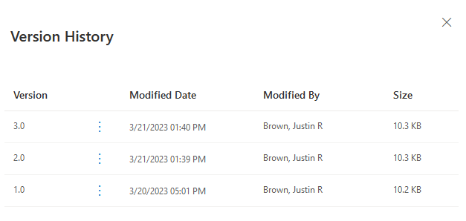
Version History
There are 3 versions of this file; Each version is designated by the date and time it was last modified, and by whom
You will always see the latest version when you open a file, but you can view/restore previous versions here

Slide 78
Install the OneDrive Desktop App to your computer

Slide 79
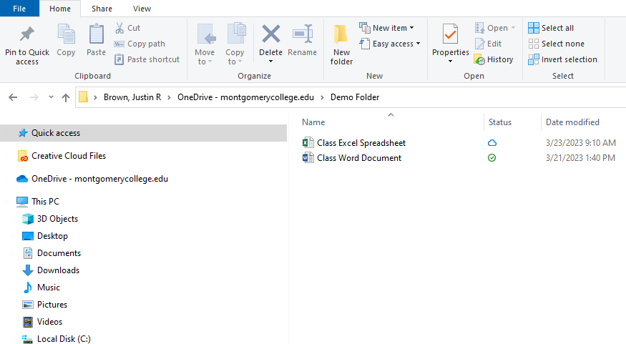
Install the OneDrive Desktop App to your computer

Slide 80
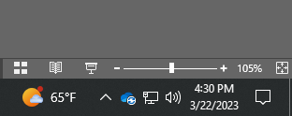
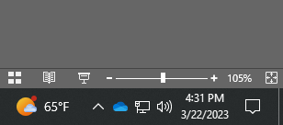
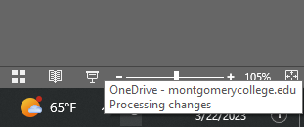
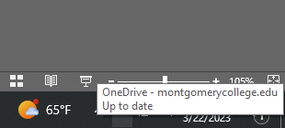
OneDrive: Backup & Sync Local Files

Slide 81
OneDrive: Mobile App

Slide 82
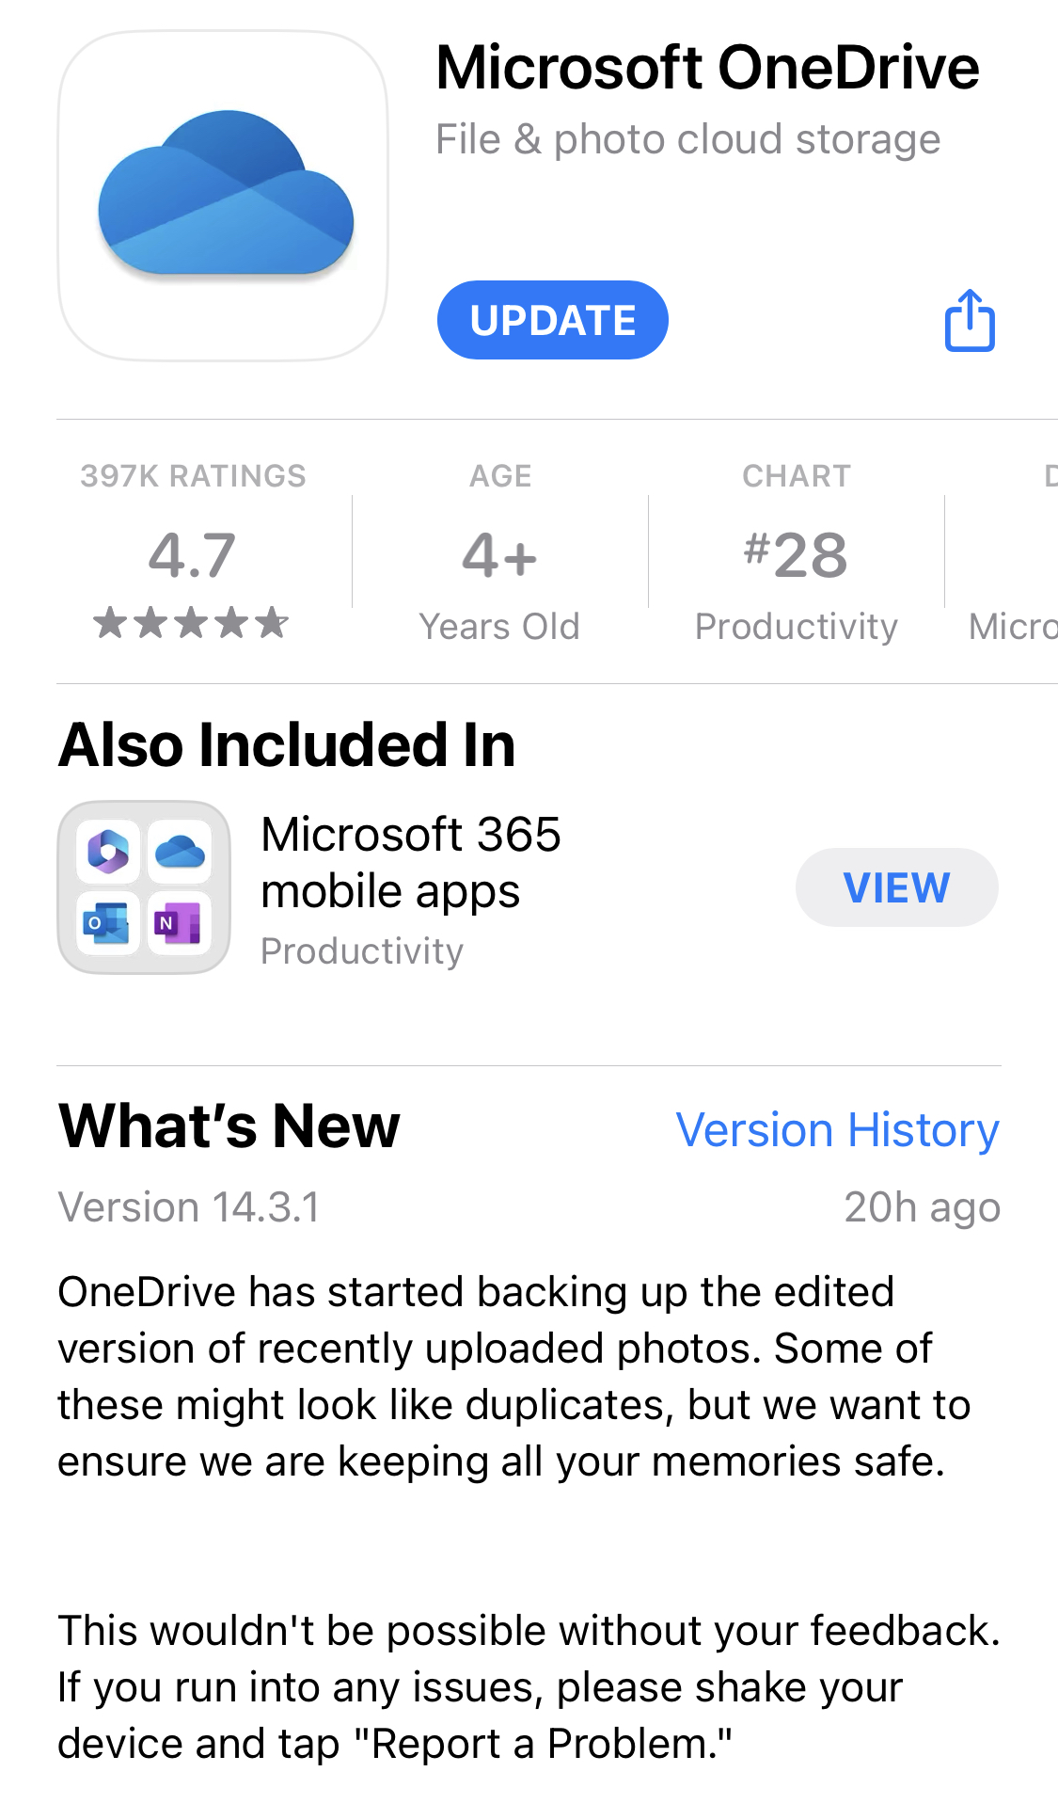
OneDrive: Mobile App

Slide 83
OneDrive: Mobile App

Slide 84
OneDrive: Mobile App

Slide 85
Exercise 4 – Download Course Files
Download Course Files to your MS 365 OneDrive.
Create MC folder - MC
Create Course Folder – VOM
Create Session Folders – Sessions 2 – 10
Sessions 2-3 Word
Sessions 4-5 Excel
Sessions 5-6 PowerPoint
Sessions 7-8 Outlook
Sessions 9-10 MS 365

Slide 86
Exercise 4 – Download Course Files
Download Course ZIP files to desktop:
Ex_Files_Word_EssT_MSFT_365.zip
Ex_Files_Learning_Excel_Desktop.zip
Ex_Files_Learning_PowerPoint_for_the_Web.zip
Ex_Files_Sway_EssT.zip
Glossary_Sway_Essential_Training_2022.zip

Slide 87
Exercise 4 – Download Course Files
Unzip files to course folders:
Ex_Files_Word_EssT_MSFT_365.zip > Session 2-3 Word
Ex_Files_Excel_EssT_MSFT_365.zip > Session 4-5 Excel
Ex_Files_PowerPoint_EssT_MSFT_365.zip > Session 6-7 PowerPoint
Ex_Files_Sway_EssT.zip > Session 6-7 PowerPoint
Glossary_Sway_Essential_Training_2022.zip > Session 6-7 PowerPoint

Slide 88
Summary
Intro to MS 365
The Cloud & File Management
One Drive
File Management

